Slide 1
New York City Taxi Trip Duration
ALY6015 21370 Intermediate Analytics SEC 14 Winter 2019 CPS
Final Presentation
Group Member:
Akshaykumar Wani,
Bhavna Chauhan,
Rohit Sharma,
Ronak Somani,
Sijia Chen

Slide 2
PART ONE
Introduction
Conclusion
Linear Regression
Time Series
EDA
Clustering
Introduction
Data Loading
Data Fields
Data
Analysis
Data prediction
Will results be helpful?
Data Visualization
Data prediction

Slide 3
PART ONE
Data Description
According to the annual INRIX Global Traffic Scorecard, New York City is the third most congested city in the world in terms of traffic and the second worst in the United States. In the last few years, the number of for-hire vehicles operating in the city has grown from 63,000 to more than 100,000.
Our goal of choosing this dataset is to predict the duration of taxi rides in NYC based on features like trip coordinates or pickup date and time.
The data has 1.5 million training observations and about 630 thousand test observations, combining pickup and drop-off times to show the total number of trips and the total number of passengers in motion at any given time.
We will firstly study and visualize the original data, then we using clustering and time series methods to provide predictions.

Slide 4
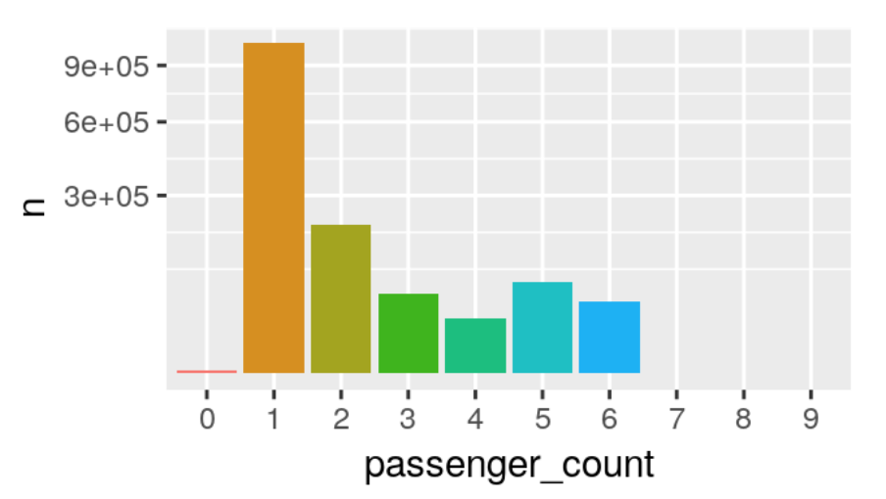
PART TWO
Exploratory Data Analysis
The most frequent number of customer?
The most frequent number of customer is one, showing that mostly, there is only one person taking the taxi in New York City.
The least frequent number of customer?
The least frequent number of customer is 7, 8, and 9. These three numbers of customers who take the taxi are exception.
Interesting Fact:
The number of 1, 2, 5 are top three counts of customers regarding New York City Taxi. There are a few trips with zero, or seven to nine passengers but they are a rare exception

Slide 5
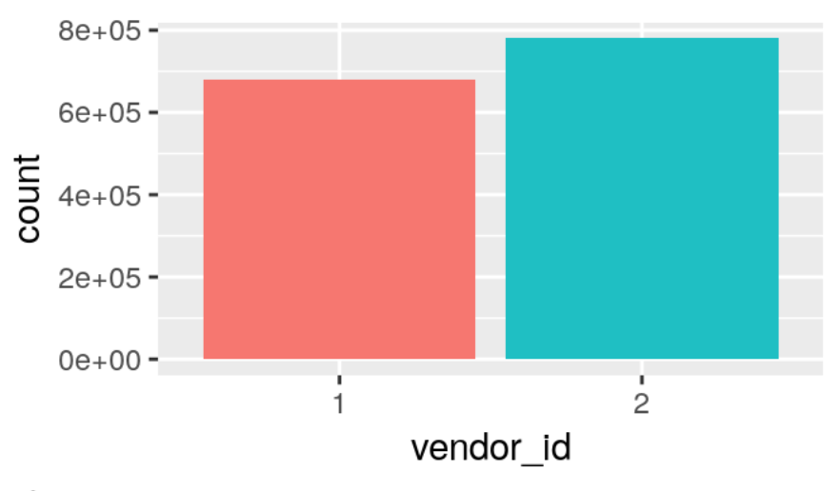
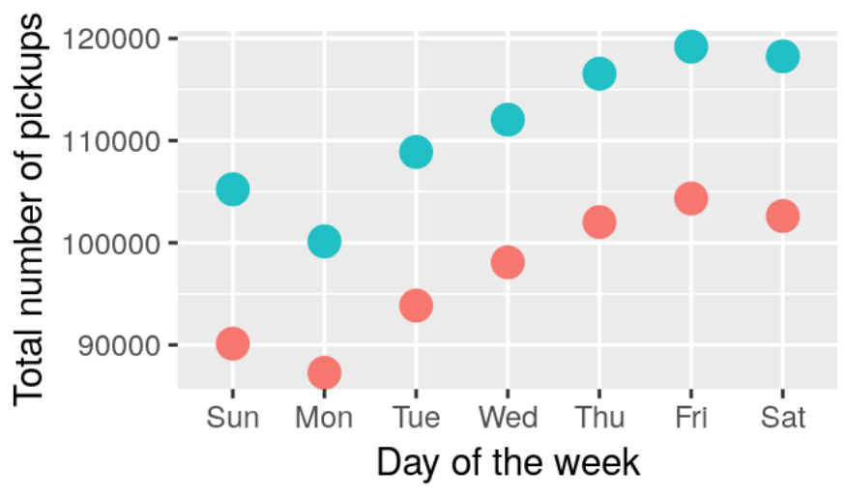
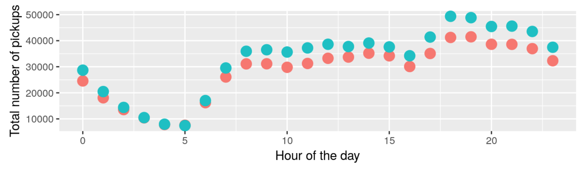
PART TWO
Exploratory Data Analysis
Count by vendor_id
Vendor 2 has significantly more trips in this dataset than vendor 1. And, this is true for every day of the week.
Total number of pickups by week
vendor_id ”1” and “2” show the almost the same trend during a week, with Monday the lowest pickup numbers and Friday the highest pickup numbers. But vendor 2 showing higher number of pickups.
Total number of pickups by hour of day
Similar pattern between vendor_id “1” and “2”, with lowest number at 5 am and the highest number at 6 pm. From 5 am to 9 am, there is an increase, because this period is the time when people start going out for work or other things; from 10 to 16, the trend appears to be stable; from 16 to 19, there is another sharp increase, because this period is the time when people are going back home from work or dinner; and from 19 to 24, the number gradually goes down. Generally speaking, this trend reflects the normal living pace of people in New York City.

Slide 6
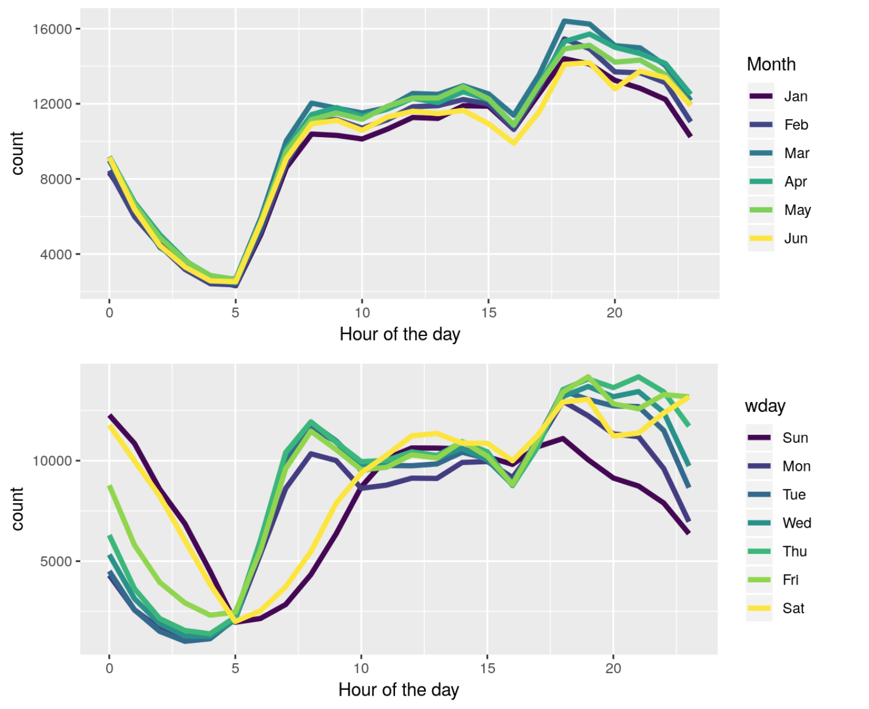
PART TWO
Exploratory Data Analysis
Count of pickups by month
January and June have fewer trips, whereas March and April are busier months. This tendency is observed for both vendor_ids. All months in the plot show the similar trend.
Count of pickups by weekday and weekends
The weekend (Sat and Sun, plus Fri to an extend) have higher trip numbers during the early morning hours but lower ones in the morning between 5 and 10, which can most likely be attributed to the contrast between NYC business days and weekend night life. In addition, trip numbers drop on a Sunday evening/night. And it could also be noticed that from Monday to Friday, the count from 5 to 10 increase more dramatically and from 19 to 24 decrease more quickly.

Slide 7
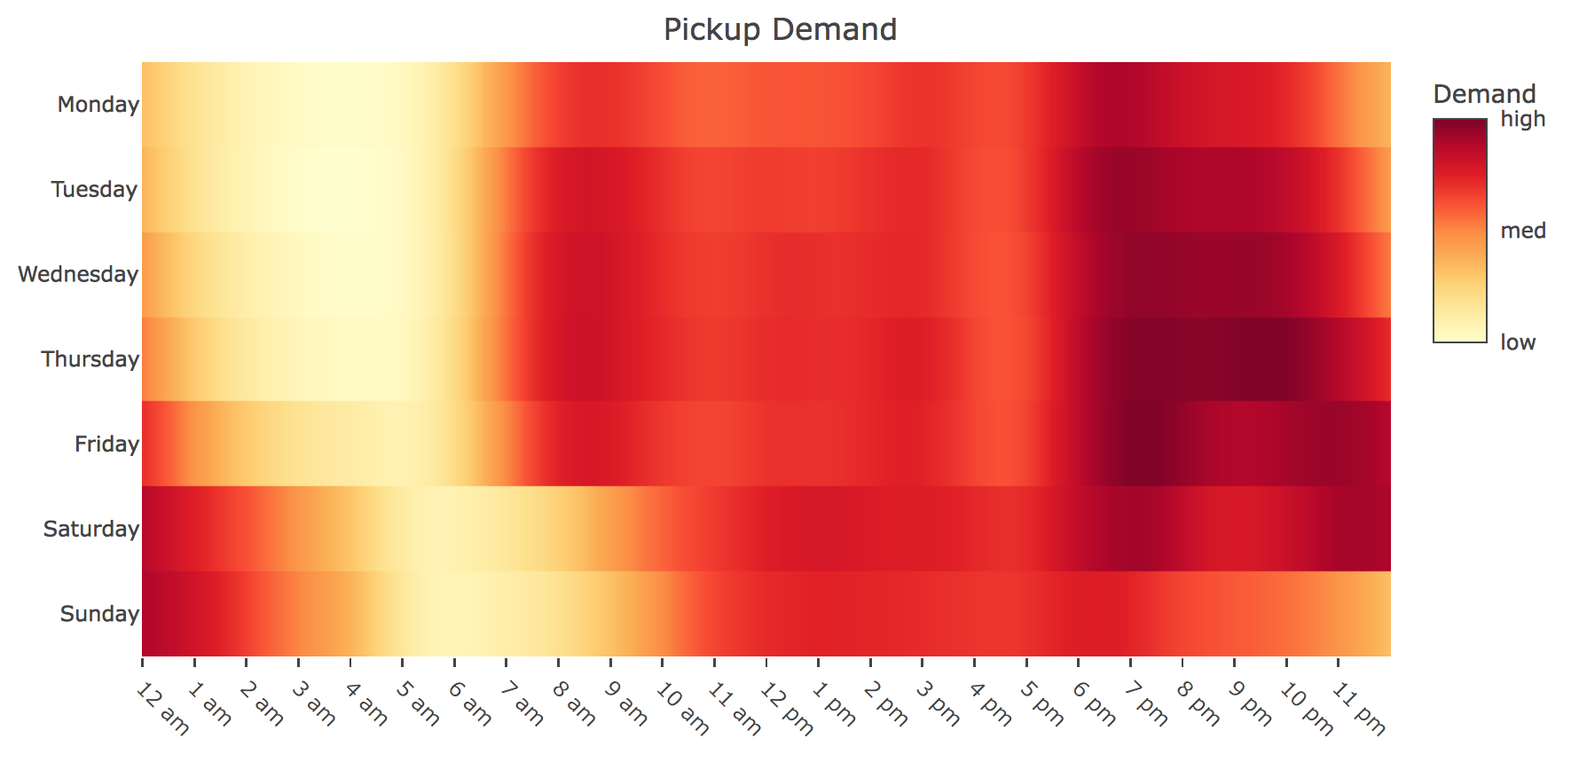
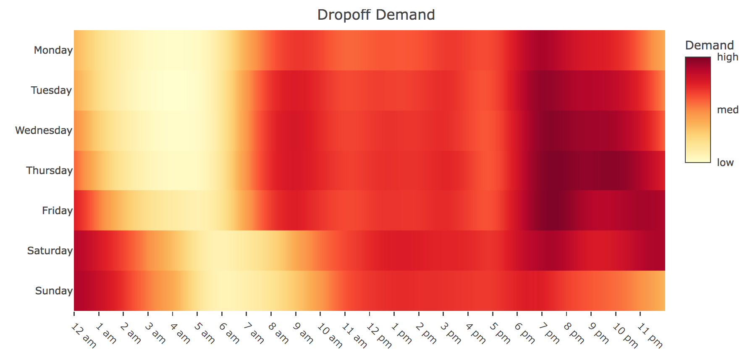
PART TWO
Exploratory Data Analysis
Heatmap purpose
estimation to show how the demand for taxi trips vary throughout the week and over the course of the day.
Weekday
Weekdays have a noticeable pattern which reflect typical work schedules (9 am to 5 pm) and lifestyles of New Yorkers. The demand for trips start picking up at 6 am and here is a small peak in demand around the start of the work day (9 am). Then there is a constant demand throughout most of the day. The demand tends to increase after 5 (after work) and the pm peak spans several hours and continues throughout the night.
Interesting Fact:
New Yorkers tend to stay out later as the work week progresses
Overall daily demand is highest on Friday.
Weekend
Weekends trend is different from weekdays. The morning rush hour peak is absent, and New Yorkers tend to stay out latest on Saturday night and Sunday morning. Besides, overall daily demand is lowest on Sunday and is missing a night crowd.

Slide 8
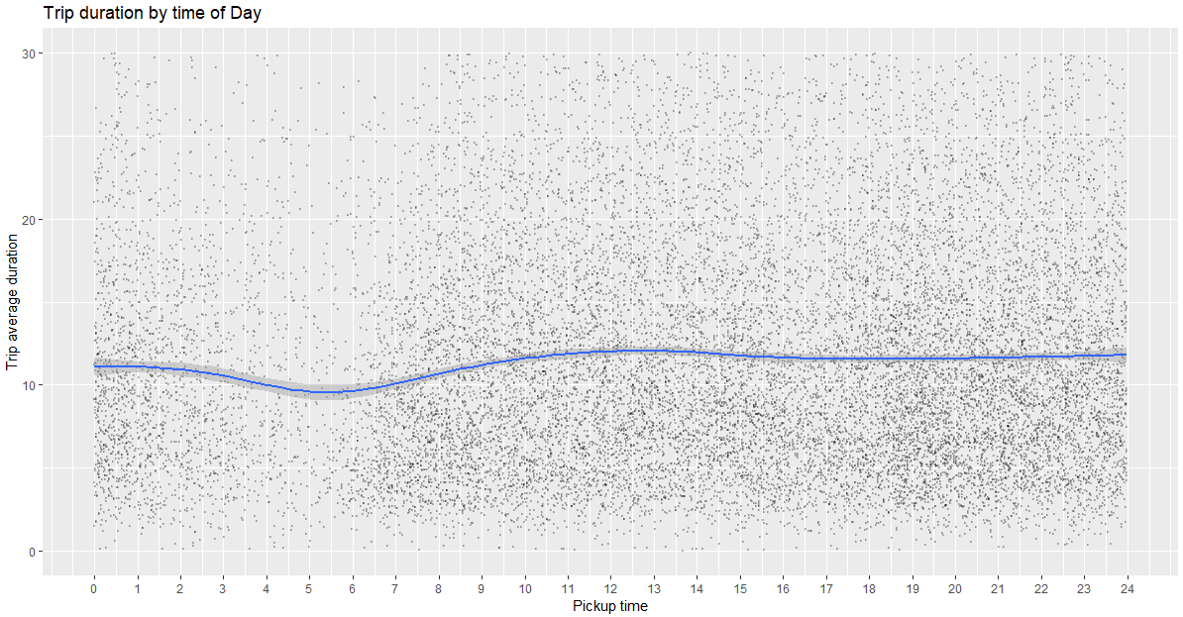
PART TWO
Exploratory Data Analysis
Sample Size
A sample set of 20000 is used to plot the duration versus time of pickup.
Interesting Fact
Time of day has a clear effect on trip duration with trips in the early morning (3 AM to 6 AM) being quicker on average.

Slide 9
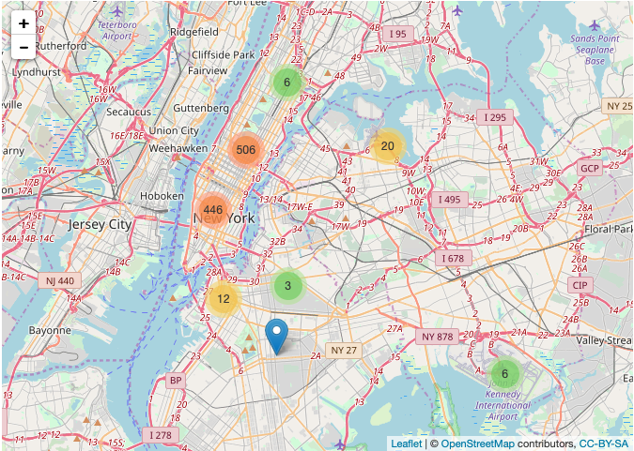
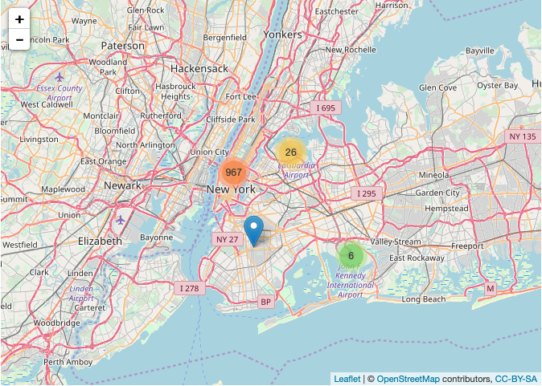
PART THREE
Clustering
An Interactive map view of 1000 random Pickup locations using leaflet is shown
From this map we can see 3 clusters of pickup locations. Where each colour tells the the most popular area with most number of pickups.
But, as we zoom into the map we see the clusters are dividing as per the pickup locations. So over here we can see 7 clusters of number of pickup locations.
Each time we zoom in the plot 3 clusters are added to give more detailed insights. Which can be very beneficial for cab industries as they can assign more cabs to the area which is more in demand.

Slide 10
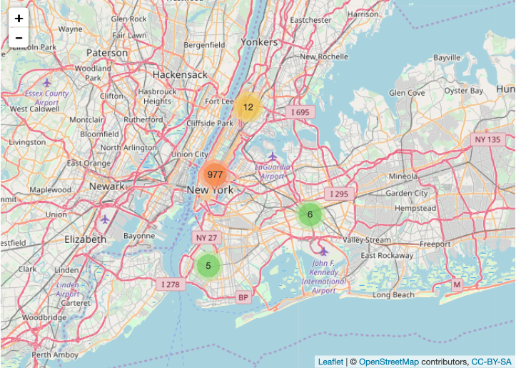
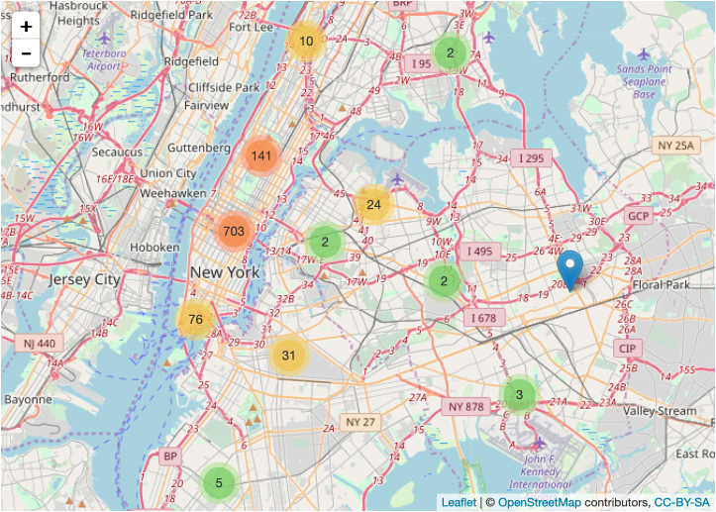
PART THREE
Clustering
Map view of corresponding drop off locations using leaflet.
This interactive map is similar to the previous map, just the difference is that instead of pickup locations it shows drop off locations.
From analyzing this the cab industry or organizations can manage the traffic flow by examining the hottest drop-off locations and can know where the most customers are going to and can smoothly manage the process.

Slide 11
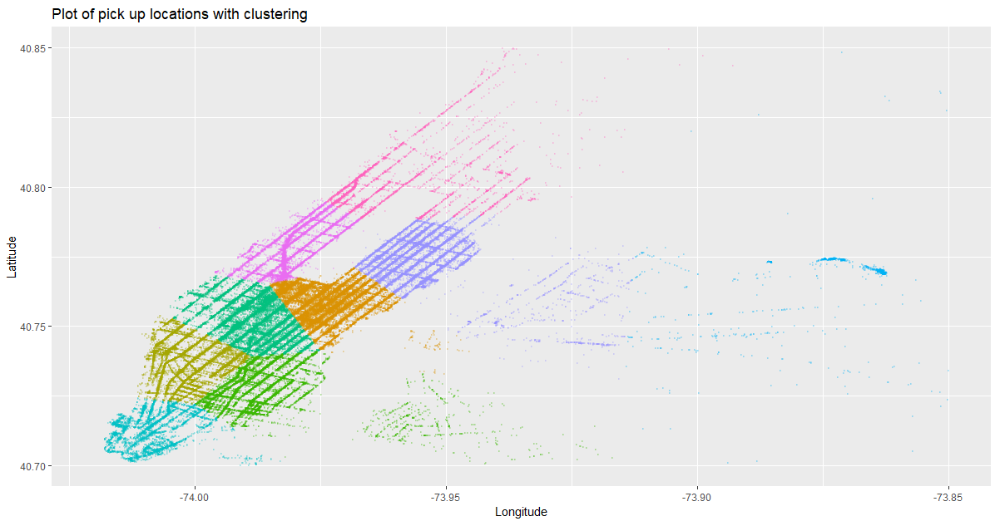
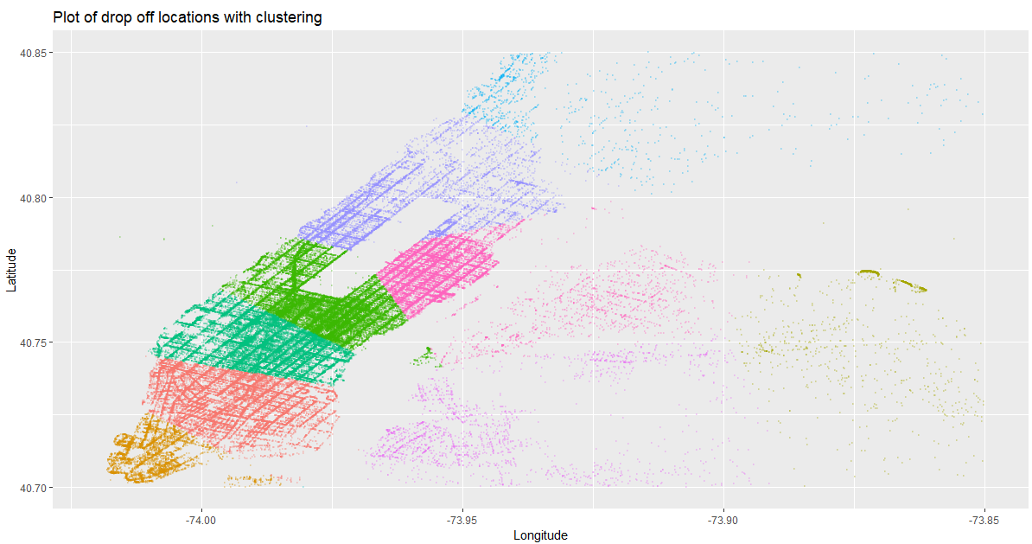
PART THREE
Clustering
Clustering of Pickup and drop off Locations
So far features collected for regression include distance, time of day and month of year. In order to improve prediction accuracy the route should be taken into account. This can be done by clustering drop off and pick up locations and including combinations as dummy variables.
First k-means clustering of pickup and drop off locations, with 50 clusters for each. Test data is included with training data for clustering to ensure test data has the cluster information available for prediction.
I choose K-means clustering because it provides a clear and straightforward visualization of the groups. And by looking at the map we can clearly visualize the most demanding pickup location and where most the customers are going too.

Slide 12
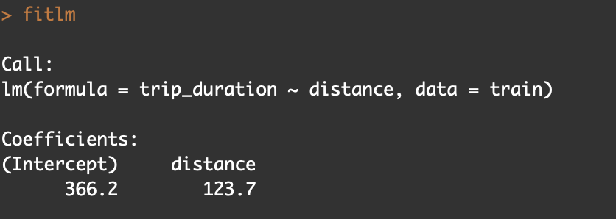
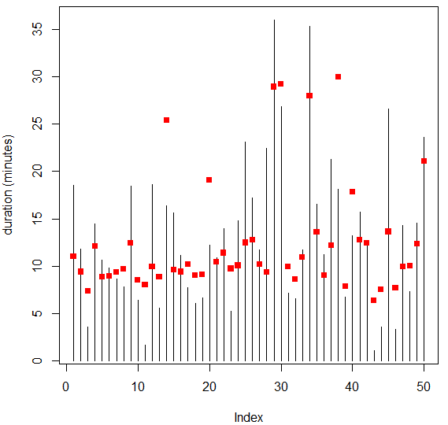
PART FOUR
Linear Regression
Fit Model
Linear regression is used on a training set of 90% of training set
Firstly a model is produced using only the distance variable to get a baseline idea of performance.
Generally the predictions do not appear to be very good. The model seems to have low variance, high bias (as expected for a simple linear model).

Slide 13
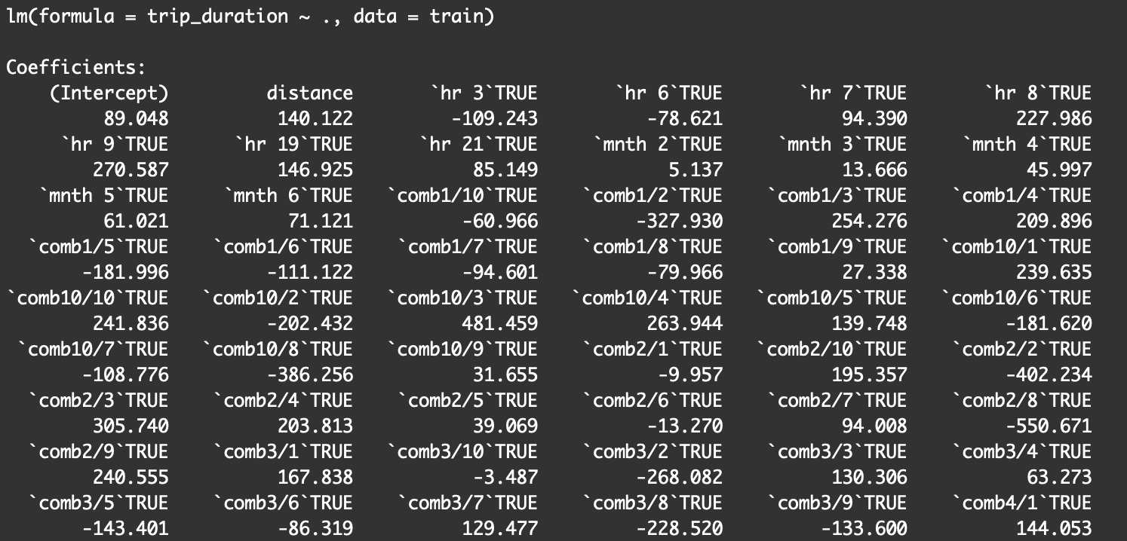
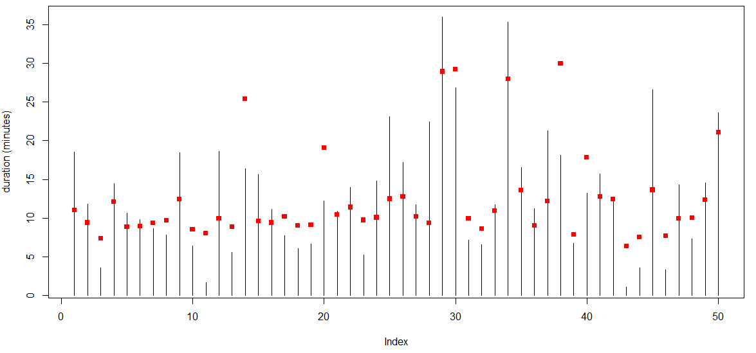
PART FOUR
Linear Regression
Linear regression is now used on the full set of features, for the same set (90%).
The plot shows that predictions in red generally agree with the actual duration in black, certainly outperforming the basic distance model.

Slide 14
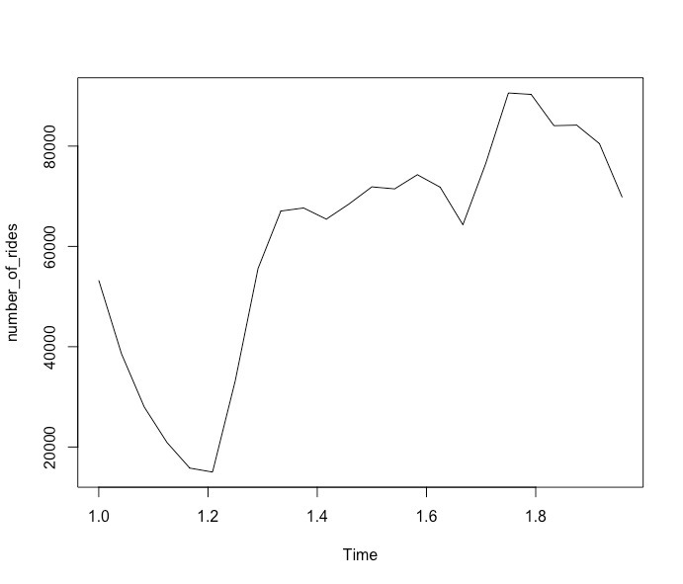
PART FIVE
Time Series
Time series analysis accounts for the fact that the data taken over time for the pickup and drop of New York Taxi may have an internal structure (such as autocorrelation, trend or seasonal variation) that should be accounted for.
Future, It can be used for forecasting and improving the Cab facility.

Slide 15
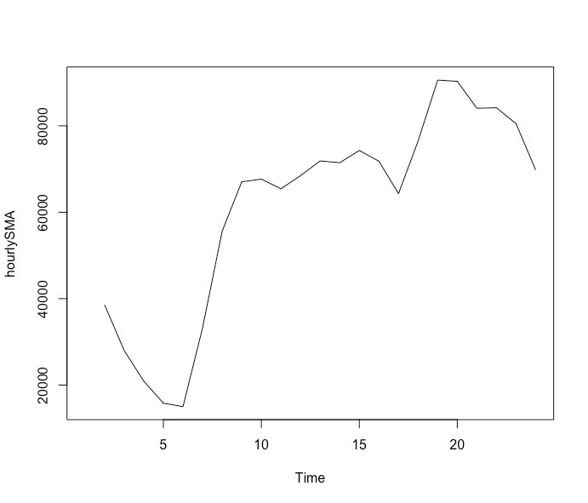
PART FIVE
Time Series
Data collected on Hourly basis.
Trend analysis on the peak hour time
Decline during the fifth hour of the day and drastic rise during the tenth hour of the day

Slide 16
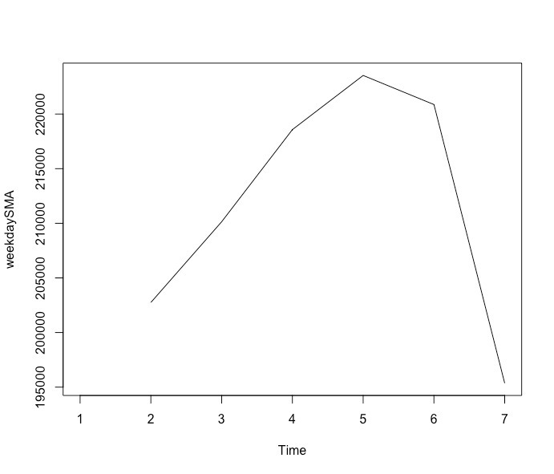
PART FIVE
Time Series
Data collected on Weekly time series
.
Increasing demand till Saturday and fall on Sunday.
.
Maximum demand between Thursday to Friday

Slide 17
PART SIX
Recommendations for the Organization
For companies who would like to build taxi business in New York City, they could use this analysis as guidance to deploy their supply of taxis and control the flow of total taxis. For example, they could send more taxis in peak hour, peak day and peak month; companies could also provide more taxis in hottest pickups areas. Besides its important to control the number of taxis, companies could arrange taxis trips in crowded locations like Manhattan or JFK airport.
For government institutions, they could take this analysis as the reference to help related departments to manage traffic conditions and adjust the route arrangement during peak time in hot areas. For example, during weekends, especially dinner time and in places that offers entertainments, there is an obvious increase of need in taxis, so organizations could control the flow on the roads on these areas in these periods ahead of time to avoid traffic jam as much as possible.
For individuals, they could use this analysis to learn more about the traffic conditions in the city where they are living in and manage their time wisely to avoid wasting too much time on the road. For example, for peak time from the centre of NYC to airport, passengers should leave and make reservations of taxis earlier.
This data can be used for classification of the rides which will help in analysing the lags the fluctuations and the reasons behind slow rides or the unavailability of rides of areas where demand is less.

